Slide 1
Fine-Grained, Massively Parallel Computation for Association Rule Mining
Damon Bruccoleri
Nova Southeastern University

Slide 2
Agenda
Define the FPGA and “Fine-Grained” Parallel Processing.
Overview of pertinent research/literature.
Agrawal, R., & Srikant, R. (1994, September). “Fast algorithms for mining association rules. “
Savasere A., Omiecinski E., & Navathe S. (Sept., 1995). “An efficient algorithm for mining association rules in large databases.”
Wur, S. Y., & Leu, Y. (1999). “An effective Boolean algorithm for mining association rules in large databases.”
Baker, Z. K., & Prasanna, V. K. (2005, April). “Efficient hardware data mining with the Apriori algorithm on FPGAs.”
Problem Statement
Proposal for Support Count circuit.
Methodology/Deliverables.

Slide 3
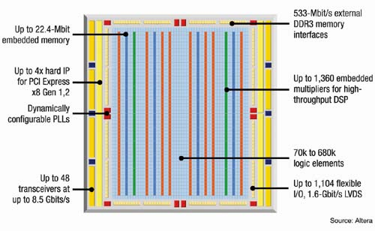
Field Programmable Gate Array (FPGA) on chip resources

Slide 4
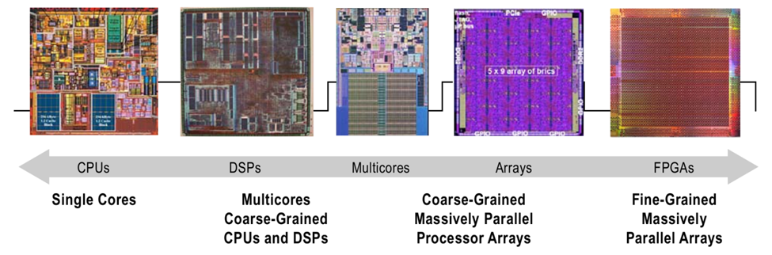
Range of Parallel Computation Technologies

Slide 5
FPGA provides for “Fine Grained” Massive Parallel Processing
“One advantage that FPGAs have over traditional computing platforms is the ability to parallelize algorithms at the operand-level granularity, as opposed to the module-level or higher.” (Sun & Zambreno, 2011).

Slide 6
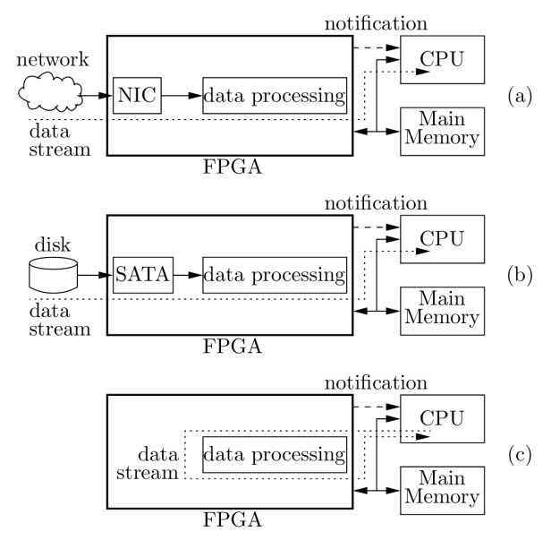
FPGA in a Data Mining system architecture
FPGA AS VLSI. I.E. “Data Mining Chip”
FPGA AS RECONFIGURABLE HARDWARE
SATA

Slide 7
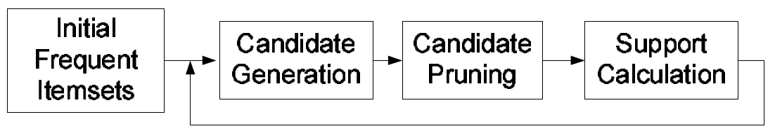
Fast Algorithm for Mining Association Rules*
OVERVIEW OF FINDING FREQUENT ITEMSETS
*(Agrawal & Srikant,1994)

Slide 8
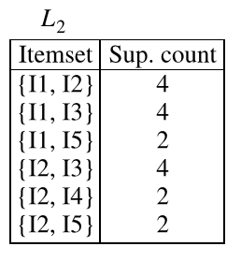
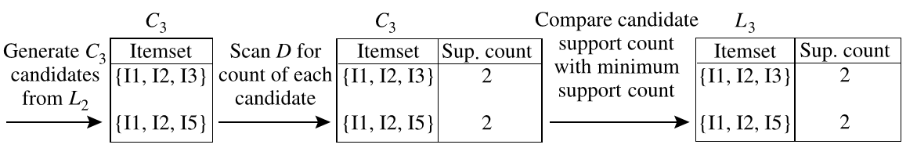
Pruning
C₃ ITEM-SET
{I₁, I₂, I₃}
{I₁, I₂, I₅}
{I₁, I₃, I₅}
{I₂, I₃, I₄}
{I₂, I₃, I₅}
{I₂, I₄, I₅}
JOIN
Check Subsets Frequent

Slide 9
Partitioning of Transaction Database*
In partitioning method the database, D, is split into n equal partitions.
The support count of a part- ition is given by n * support over the whole database.
A frequent item-set in the database, D, must be frequent in at least one partitions.
In the last step calculate the support count over the whole database of the individual frequent item-sets and calculate the association rules.
Candidate for parallel processing of partitions.
*(Savasere, Omiecinski, & Navathe,1995)
}
n

Slide 10
An Effective Boolean Algorithm for Mining Association Rules in Large Databases
Proposed by Suh-Ying Wur and Yungho Leu (1999) for Binary Association Rule Mining.
Uses “sparse matrices”. An items presence/absence in a set is represented by a 1 or 0.
Degenerates Apriori algorithm into AND, OR, XOR operations
Researchers target was not parallel processing hardware (Sun Workstation).
A | B | C | D | E
1 | 0 | 1 | 0 | 0

Slide 11
Apriori degenerated to Boolean Operations
Database D
TID | ITEMS
100 | ACD
200 | BCE
300 | ABCE
400 | BE
ITEMSET {A, B, C, D, E}
Min Support =40%
Min Confidence = 50%
TI
TT
C
1
 | A | B | C | D | E
A | 1 | 0 | 0 | 0 | 0
B | 0 | 1 | 0 | 0 | 0
C | 0 | 0 | 1 | 0 | 0
D | 0 | 0 | 0 | 1 | 0
E | 0 | 0 | 0 | 0 | 1
T100 | T200 | T300 | T400
1 | 0 | 1 | 0
0 | 1 | 1 | 1
1 | 1 | 1 | 0
1 | 0 | 0 | 0
0 | 1 | 1 | 1
C
2
3
3
1
3
E | 0 | 0 | 0 | 0 | 1 | 0 | 1 | 1 | 1 | 3

Slide 12
Generate next frequent k itemsets
Get a pair of different rows in TI_{k-1}.
Apply OR operation
If set contains more than k items, or has already been produced, goto step 1.
Apply AND operation on TT_{k-1}.
TITTC0
 | A | B | C | D | E
A | 1 | 0 | 0 | 0 | 0
B | 0 | 1 | 0 | 0 | 0
T100 | T200 | T300 | T400
1 | 0 | 1 | 0
0 | 1 | 1 | 1
 | A | B | C | D | E
A | 1 | 0 | 0 | 0 | 0
B | 0 | 1 | 0 | 0 | 0
C | 0 | 0 | 1 | 0 | 0
D | 0 | 0 | 0 | 1 | 0
E | 0 | 0 | 0 | 0 | 1
T100 | T200 | T300 | T400
1 | 0 | 1 | 0
0 | 1 | 1 | 1
1 | 1 | 1 | 0
1 | 0 | 0 | 0
0 | 1 | 1 | 1
OR
AND
COUNT
AB | 1 | 1 | 0 | 0 | 0
0 | 0 | 1 | 0
1

Slide 13
TITTC₂
 | A | B | C | D | E | 100 | 200 | 300 | 400 | C
AB | 1 | 1 |  |  |  |  |  | 1 |  | 1
AC | 1 |  | 1 |  |  | 1 |  | 1 |  | 2
AD | 1 |  |  | 1 |  | 1 |  |  |  | 1
AE | 1 |  |  |  | 1 |  |  | 1 |  | 1
BC |  | 1 | 1 |  |  |  | 1 | 1 |  | 2
BE |  | 1 |  |  | 1 |  | 1 | 1 | 1 | 3
CE |  |  | 1 |  | 1 |  | 1 | 1 |  | 2
 | A | B | C | D | E | 100 | 200 | 300 | 400 | C
AC | 1 |  | 1 |  |  | 1 |  | 1 |  | 2
BC |  | 1 | 1 |  |  |  | 1 | 1 |  | 2
BE |  | 1 |  |  | 1 |  | 1 | 1 | 1 | 3
CE |  |  | 1 |  | 1 |  | 1 | 1 |  | 2

Slide 14
Generating TITTC3
 | A | B | C | D | E | 100 | 200 | 300 | 400 | C
AC | 1 |  | 1 |  |  | 1 |  | 1 |  | 2
BE |  | 1 |  |  | 1 |  | 1 | 1 | 1 | 3
ABCE | 1 | 1 | 1 |  | 1 |  |  | 1 |  | 1
This gets thrown out because more than 4 1’s in TI
 | A | B | C | D | E | 100 | 200 | 300 | 400 | C
BE |  | 1 |  |  | 1 |  | 1 | 1 | 1 | 3
CE |  |  | 1 |  | 1 |  | 1 | 1 |  | 3
BCE |  | 1 | 1 |  | 1 |  | 1 | 1 |  | 2
This is the only one that stays

Slide 15
TITTC3
 | A | B | C | D | E | 100 | 200 | 300 | 400 | C
BCE |  | 1 | 1 |  | 1 |  | 1 | 1 |  | 2

Slide 16
Efficient Hardware Data Mining with the Apriori Algorithm on FPGA’s
Baker & Prasanna degenerate the Apriori algorithm into a systolic processing architecture.
They configured the systolic array from a Xilinx FPGA Virtex II Pro XC2VP100.
“The third phase of the algorithm is the support calculation. It is by far the most time consuming and data intensive part of the application, as during this phase the database is streamed into the system.“

Slide 17
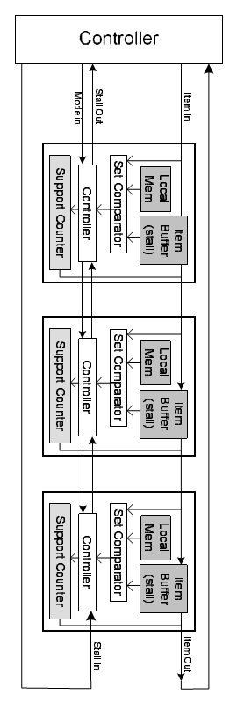
Efficient Hardware Data Mining with the Apriori Algorithm on FPGA’s
Pipeline of 560 units.

Slide 18
Problem Statement
The Apriori Algorithm is a CPU and I/O intensive algorithm, relative to particular applications. A Field Programmable Gate Array (FPGA) provides the capability of fine-grained, high speed, massively parallel computing. The problem is to find an expression of the Apriori Algorithm capable of utilizing the advantages of an FPGA to accelerate the mining of Association Rules.

Slide 19
Goal
The goal for this research project breaks off one piece of this larger problem.
This research proposes to implement and benchmark an FPGA circuit capable of providing a support count of candidate item-sets from the Transaction Database in an FPGA.

Slide 20
Fine Grained processing of item-set support counting
Transaction
Database
“Support count in 1 or a few clocks”

Slide 21
Possible implementation

Slide 22
Example
Database D
TID | ITEMS
100 | ACD
200 | BCE
300 | ABCE
400 | BE
{B,E}
01001
10110
0
Match?
01101
1 bit Half
Adder
1
Match?
01
2 bit
Half
Adder
011
11101
10
Match?
1
1 bit Half
Adder
01001
Match?
1

Slide 23
Verilog Code (preliminary)
Click Here

Slide 24
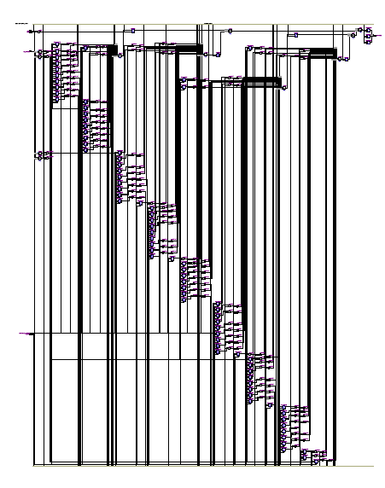
Circuit from Quartus RTL viewer
Click Here

Slide 25
Methodology
Identified an FPGA platform. Altera University DE1 board.
Prototype Algorithm(s).
Identify appropriate benchmark database. Baker and Prasanna use the T40I10D100K (15 MB) and 10I4D100k (4MB) datasets.
Benchmark Algorithm.

Slide 26
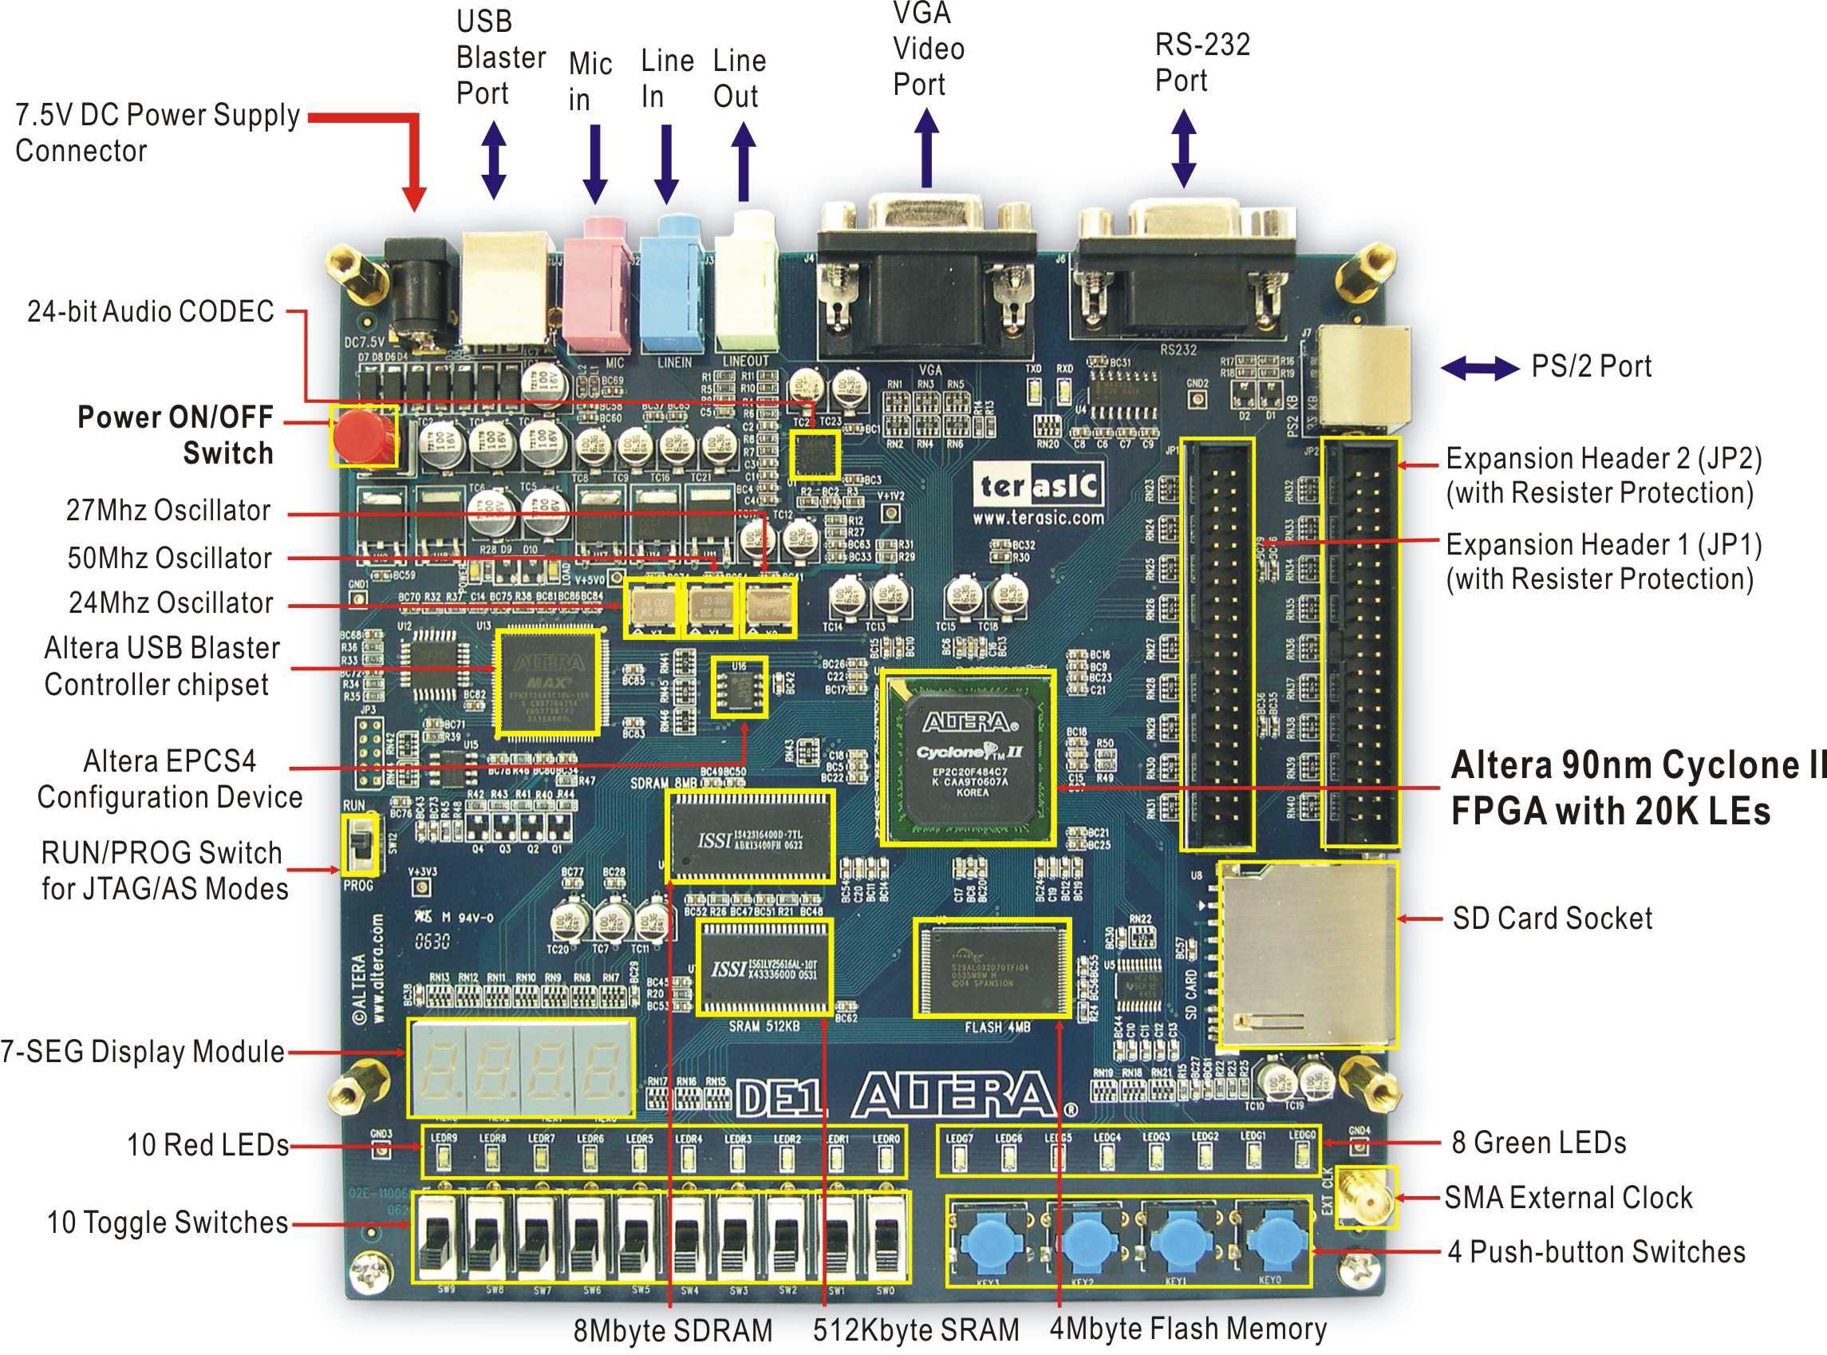
Altera DE1 University FPGA demo board

Slide 27
References
Agrawal, R., & Srikant, R. (1994, September). Fast algorithms for mining association rules. In Proc. 20th Int. Conf. Very Large Data Bases, VLDB Vol. 1215, pp. 487-499.
Baker, Z. K., & Prasanna, V. K. (2005, April). Efficient hardware data mining with the Apriori algorithm on FPGAs. In Field-Programmable Custom Computing Machines, 2005. FCCM 2005. 13th Annual IEEE Symposium on pp. 3-12. IEEE.
Savasere A., Omiecinski E., & Navathe S. (Sept., 1995). An efficient algorithm for mining association rules in large databases. International Conf. Very Large DataBases VLDB’95, pp. 432–443, Zurich, Switzerland.
Singh, D. (2012). Implementing FPGA design with the OpenCL standard. Altera whitepaper.
Sun, S., & Zambreno, J. (2011). Design and analysis of a reconfigurable platform for frequent pattern mining. Parallel and Distributed Systems, IEEE Transactions on, 22(9), pp. 1497-1505.
Wur, S. Y., & Leu, Y. (1999). An effective Boolean algorithm for mining association rules in large databases. In Database Systems for Advanced Applications, 1999. Proceedings., 6th International Conference on, pp. 179-186. IEEE.

